Slide 1
Key Partners and partnerships: The OECD, brazil and TCU
Janos Bertok
Head of Division, Public Sector Integrity
Public Governance and Territorial Development Directorate

Slide 2
The OECD Today

Slide 3
Active with Brazil
2007: Brazil becomes OECD Key Partner
Participation in PISA
Investing in Youth: Brazil 2014
Improving Decentralised Public Policies and Programmes: Outcome-driven auditing (2017-2019)
Innovation, Agricultural Productivity and Sustainability in Brazil
OECD-Brazil co-operation agreement signed
SAIs and Citizen’s Engagement Project (2014)
Water Resources Governance in Brazil
November 2015
Presenting “Supreme Audit Institutions: oversight, insight and foresight”
Signing of OECD-Brazil Programme of Work and new TCU-OECD collaboration
OECD Economic Survey (2015)
Work with TCU
2015 +
Review of TCU’s audit of year-end consolidated government report (2012)
SAIs and Good Governance: Phase I (2014)
SAIs and Good Governance: Phase III (2015-2016)
2015 +
Notes:
The OECD Council at Ministerial level adopted a resolution on 16 May 2007 to strengthen the co-operation with Brazil as a “Key Partner” of the OECD.
As a Key Partner, Brazil has access to Partnerships in OECD Bodies, adherence to OECD instruments, integration into OECD statistical reporting and information systems, sector-specific peer reviews, and has been invited to all OECD meetings at Ministerial level since 1999. On 3 June 2015, The OECD and Brazil signed a new Co-operation Agreement, which will take a longstanding partnership to a new level. The new Joint programme of work is being signed this afvternoon.
This results in a mutually beneficial relationship. Brazil values the opportunity to discuss major policy issues and challenges in a multilateral context and to learn from the experiences of OECD countries facing similar challenges in many areas. The relationship also benefits OECD members and non-OECD economies by enabling them to acquire a better understanding of Brazil as it has become a major actor in the globalised economy.
Brazil participates in the substantive work of many of the OECD’s specialised Committees, where senior officials from member and partner countries meet to advance ideas and review progress in specific policy areas. Brazil has also engaged in a productive dialogue with the OECD in the framework of the G20, leading to its engagement in the Base Erosion and Profit Shifting (BEPS) project.
Brazil hosted the High Level Policy Forum on Skills for Social Progress on 24-25 March 2014. The Forum was jointly organised by the Ministry of Education of Brazil, the National Institute for Educational Studies and Research (INEP), the Ayrton Senna Institute and the OECD Centre for Educational Research and Innovation (CERI). The Forum brought together education leaders from around the world to discuss ways to better prepare our children in face the diverse socioeconomic challenges of the 21st century. Brazil is also active in six OECD-LAC Regional Forums and Networks.

Slide 4
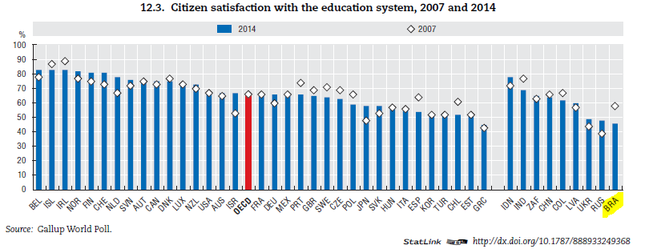
Governance challenges
Financial woes have highlighted limitations in:
co-ordination, planning, and risk management;
flexibility and responsiveness to economic and social demands;
fairness of decision making
Led to a decline in trust and satisfaction with public services
Notes:
The key point to highlight here is that citizens are questioning the value of government, and whether their government takes their interests into account.

Slide 5
Governance solutions: the OECD approach
The new context demands new analytical approaches and a whole-of-government approach
Doing more with less is the name of the game
Inclusiveness and transparency in approaches and outcomes
A “strategic and open state” capable of facing governance challenges ensures:
Integrity
Reliability
Openness and inclusiveness
Risk management
Responsiveness
Notes:
risk management: the ability of governments to minimise uncertainty in the economic, social and political environment of their citizens, and to act in a consistent and predictable manner;
responsiveness: the provision of accessible, efficient and citizen-oriented public services that effectively address the needs and expectations of tax payers;
reliability: the ability of governments to report factual information about its operations and use of public resources;
openness and inclusiveness: a systemic, comprehensive approach to institutionalising a two-way communication with stakeholders, whereby relevant, usable information is provided, and interaction is fostered as a means to improve transparency, accountability and engagement; and
integrity: the alignment of government and public institutions with broader principles and standards of conduct that contribute to safeguarding the public interest while preventing corruption (OECD, 2013b).

Slide 6
Striving for Good Governance
Focus on establishing a robust evidence base
Government at a Glance, Economic Outlook
Focus on aligning good practices
OECD Recommendation on enhancing integrity in Public Procurement, Principles of Budgetary Governance, The OECD Anti-Bribery convention
Making country-specific applications
Public Governance Reviews, Integrity Reviews, Economic Surveys
Accompanying countries and institutions in the long-term
Progress and follow-up reports
Notes:
Points to make: The OECD is recognised internationally for its instruments, Peer Review Mechanisms and data, with benchmarking and also country application.
More and more moving towards capacity, and following up on our work

Slide 7
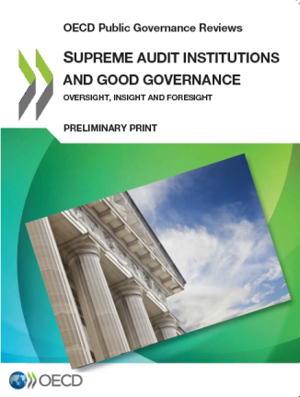
Our work with SAIs
Supporting SAIs in meeting the expectations of the 21st century
Linking governance challenges with objective oversight, insight and foresight
Capability: Review of Chile’s Supreme Audit Institution, and the Moroccan Court of Accounts – in supporting SAI capacity
Thematic: SAIs and Good Governance, and oversight of decentralised government policies – in support of SAIs for SDGs and the Working Group on KNIs
National Auditing System: Review of Mexico – in support of OLACEFs’ Anti-Corruption initiatives
International: OECD-TCU’s SAIs and Good Governance – in support of INTOSAI’s Value and Benefits for Citizens

Slide 8
supreme audit institutions and good governance: oversight, insight and foresight
Alison McMeekin
Policy Analyst, Public Sector Integrity
Public Governance and Territorial Development Directorate

Slide 9
SAIs and Good Governance
Background: there is an evolution in SAI work and an opportunity to link it with governance challenges
“Supreme Audit Institutions and Good Governance: oversight, insight and foresight” systematically maps the contributions of SAIs against key functions of the policy cycle
Purpose of the study is to facilitate SAI contribution to strengthening good governance, through their audit and counselling work
Objective is to inform and inspire dialogues on the role of the SAI
Approach is to link examples of audit work with governance challenges
Based on experiences in: Brazil, Canada, Chile, France, Korea, Netherlands, Poland, Portugal, South Africa and the United States.
Notes:
Highlighting the two ways in which we’re considering SAI’s contributions to Good Governance. On the one hand they provide oversight thereby supporting accountability and integrity (more about ensuring compliance and regularity).
(Next slide: But more and more we’re seeing SAIs providing insight and foresight on the functioning of programmes and processes (through mainly, but not limited to, performance audits, research, consultations etc.)).
It’s through their traditional oversight role that SAIs generally do well in perception-based surveys on integrity and corruption risks (in Transparency International’s National Integrity System Assessment, SAIs came out as top performing entity). Trust and rule of law is needed to revitalise and to encourage investment, particularly where short term sacrifices need to be made for long term sustainability, and where citizens are demanding that their interests are being taken into account. SAIs can play a key role in (re)gaining trust in public management. This feeds back into a government’s ability to be strategic and agile, and so the cycle continues.
This makes SAIs key actors in the OECD’s whole-of-government approach.
Examples to highlight:
Chile’s Office of the Comptroller General of the Republic of Chile (CGR), introduced in 2014 its innovative GEO-CGR portal, which provides a forum for the articulation, storage, consultation and publication of the information on the investment of resource in public works. Its ultimate aim is to promote social control and citizen-driven accountability by providing reliable and timely information useful for analysing and monitor resources invested in public works
Portugal’s SAI – the Tribunal de Contas – assessed “the Internal audit function within the State owned Enterprises” for the year 2008, with a view to strengthening internal controls and overall governance of the selected entities. The performance audit sought to: evaluate the internal audit function in public sector enterprises, comparing it to international best practices and assessing the influence of governance models of entities on the effectiveness of the internal audit function. (http://www.tcontas.pt/en/reports/audit_report_08-2011-2s_abstract.pdf )
The Netherland’s Court of Audit’s State of integrity management in central government (2009) investigated the status of integrity management of ministries. By asking “how do they ensure civil servants are incorruptible and trustworthy?” the NCA used the audit to promote that preventative, detective and repressive measures were needed to avoid violations of integrity. The 2009 audit was a follow-up to a baseline measurement undertaken in 2004. (http://www.courtofaudit.nl/english/Themes/Public_administration/Integrity)

Slide 10
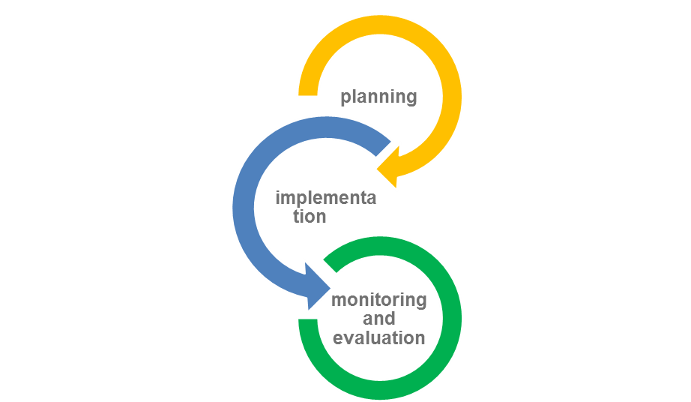
1. SAIs are active in providing oversight, insight and foresight on the policy cycle
The policy cycle |  | Key functions of a strategic and open state
The feedback loop |  | Strategic whole-of-government steering
 |  | Budgetary planning
 |  | Establishing regulatory policy
 |  | Creating risk management and internal control policies
 |  | Co-ordinating and communicating
 |  | Implementing the budget
 |  | Implementing and enforcing regulatory policy
 |  | Establishing processes for risk management and internal control
 |  | Evaluating for results
 |  | Oversight and accountability
Notes:
The activities and data in the report are presented around their contributions to the policy cycle – looking at examples of SAIs in assessing and supporting the institutions and processes required to develop and deliver better policies.
In each case, examples and challenges of government in achieving key functions are mapped against SAI activities in those areas.

Slide 11
Main findings
Peer SAIs are active in providing oversight, insight and foresight on key functions of the policy cycle
SAIs are getting innovative – diversity in the audit portfolio
Taking initiative and being responsive
SAIs’ limitations have a lot to do with factors within their control
A greater awareness of the role of SAIs will support relevance and impact

Slide 12
1. SAIs are active in providing oversight, insight and foresight on the policy cycle
SAIs’ oversight is critical to accountability and integrity.
SAIs provide reasonable assurance that public resources are used legally, for their intended purpose, as well as economically, efficiently, and effectively.
Examples of good practices in providing oversight for accountability:
Assess internal audit function of state-owned enterprises (e.g. Portugal SAI’s review of internal audit functions)
Evaluate integrity management (e.g. the Netherlands Court of Audit’s review of ministries)
Assessing conflict of interest management (e.g. The European Court of Auditor’s)
Notes:
Highlighting the two ways in which we’re considering SAI’s contributions to Good Governance. On the one hand they provide oversight thereby supporting accountability and integrity (more about ensuring compliance and regularity).
(Next slide: But more and more we’re seeing SAIs providing insight and foresight on the functioning of programmes and processes (through mainly, but not limited to, performance audits, research, consultations etc.)).
It’s through their traditional oversight role that SAIs generally do well in perception-based surveys on integrity and corruption risks (in Transparency International’s National Integrity System Assessment, SAIs came out as top performing entity). Trust and rule of law is needed to revitalise and to encourage investment, particularly where short term sacrifices need to be made for long term sustainability, and where citizens are demanding that their interests are being taken into account. SAIs can play a key role in (re)gaining trust in public management. This feeds back into a government’s ability to be strategic and agile, and so the cycle continues.
This makes SAIs key actors in the OECD’s whole-of-government approach.
Examples to highlight:
Portugal’s SAI – the Tribunal de Contas – assessed “the Internal audit function within the State owned Enterprises” for the year 2008, with a view to strengthening internal controls and overall governance of the selected entities. The performance audit sought to: evaluate the internal audit function in public sector enterprises, comparing it to international best practices and assessing the influence of governance models of entities on the effectiveness of the internal audit function. (http://www.tcontas.pt/en/reports/audit_report_08-2011-2s_abstract.pdf )
The Netherland’s Court of Audit’s State of integrity management in central government (2009) investigated the status of integrity management of ministries. By asking “how do they ensure civil servants are incorruptible and trustworthy?” the NCA used the audit to promote that preventative, detective and repressive measures were needed to avoid violations of integrity. The 2009 audit was a follow-up to a baseline measurement undertaken in 2004. (http://www.courtofaudit.nl/english/Themes/Public_administration/Integrity)
ECA’s audit on conflict of interest: evaluation of the policies and procedures for the management of conflict of interest situations that were in place in up to October 2011 in four selected European agencies,
The ECA found that none of the selected four agencies adequately managed conflict of interest. A number of shortcomings were identified in agency-specific policies and procedures as well as in their implementation.
In December 2013, the Commission, in close cooperation with the agencies, produced guidelines to provide a clear reference for the policies to be adopted and implemented by each agency.
The audit was the first to be performed by the ECA on conflict of interest policies, and on the broader field of ethics and integrity. In the absence of clear legal requirements and criteria, the audit successfully used internationally recognised principles and comparative analysis.

Slide 13
1. SAIs are active in providing oversight, insight and foresight on the policy cycle
SAIs are integrating value-for-money criteria into their audit activities to drive better policy-making
SAIs are providing insight and foresight through performance auditing, compliance auditing, verbal and written guidance and research projects
Good practice examples for insight and foresight include:
Incorporate and tailor internationally-recognized standards (e.g. U.S. GAO’s Standards for Internal Control and Fraud Risk Management Framework)
Coordinate with the Executive to implement recommendations and target inefficiencies (e.g. Audit General of South Africa study of MDGs for literacy)
Assess the effectiveness and efficiency of regulatory policy (Korea’s Board of Audit review of the design and implementation of regulatory frameworks)
Notes:
INTOSAIs Standards on the Value and Benefits of Supreme audit institutions states the following: “… Audit… supports desirable values and underpins accountability mechanisms, which in turn leads to improved decisions. Once SAIs’ audit results have been made public, citizens are able to hold the custodians of public resources accountable. In this way SAIs promote the efficiency, accountability, effectiveness and transparency of public administration.”
This is true. However, our current work on the role of SAIs and Good Governance is also exploring the ways in which audit work directly supports improved decision-making and governance.
Good practice examples include:
GAO Green Book – I’ll let you elaborate here Gavin, but the main point to highlight in my view is that this is a good example of a SAI integrating internationally recognised standards, tailoring them to the public sector context, and disseminating through the public sector, with the collaboration of OMB.
A 2013-2014 Education Sector Report of the Auditor General of South Africa studied at progress against MDG goals for literacy in South Africa, which aimed to enable 4.7 million functionally illiterate and semi-literate adults to become literate and numerate in one of thw 11 official languages by 2015. AGSA worked with programme management to begin with early implementation of the audit recommendations in order to readjust and target inefficiencies that in view of the MDG goal of 2015. This is a good example of the ways that SAIs are targetting citizen-sensitive policies, while integrating international goals (MDGs)
Korea’s BAI has been active, through financial and compliance auditing, in the realm of regulatory policy, looking for the effective application of regulatory tools, the effectiveness of regulations, and at for regulatory management capacity. Two examples include: BAI’s 2007 Implementation of Economic Regulatory Reform assessed the performance of 12 central government agencies and 8 local governments. While it analyses the adequacy of the whole planning process, the focus was on downstream implementation of the regulatory reform and the registration of newly established regulations. BAI’s 2009 The Implementation of Regulatory Reform in the fields of Education, Health Services and Tourism examines the regulatory reform performance of 4 central government agencies and 5 local governments. It identifies weaknesses in the agencies’ regulatory frameworks and provides recommendations to improve their performance.

Slide 14
1. SAIs are active in providing oversight, insight and foresight on the policy cycle
Frequency of SAI activity across the policy cycle
Notes:
This study shows that the majority of SAIs surveyed are active in evaluating good governance approaches of every single stage of the policy cycle (Figure 10). In other words, SAIs are assessing many of the same processes that some governments are considering in light of ongoing fiscal consolidation and efforts to streamline government processes.

Slide 15
2. SAIs are getting innovative – diversity in the audit portfolio
Compliance audits (78%)
Performance audits (75%)
Financial audits (56%)
Written guidance (43%)
Research (33%)
Verbal guidance (25%)
Notes:
Of the activities that the peer SAIs were undertaking in assessing the policy cycle, the most common were compliance audits, but commonly, in order: performance audits, financial audits, written guidance, research and verbal guidance

Slide 16
3. Taking initiative and being responsive
Impetus for SAI activities for select elements of the policy cycle (percentage of time)
Stage of the Policy Cycle | Key Function of the Policy Stage | Required by Mandate | Requested | SAIs' discretion
Policy Formulation | Strategic planning | 29.2 | 7.3 | 63.5
 | Budgetary planning | 40.2 | 12.6 | 47.2
 | Establishing rules and controls | 37.7 | 8.6 | 53.7
Policy Implementation | Co-ordinating and communicating | 29.1 | 7.3 | 63.6
 | Implementing the budget | 52.7 | 7.1 | 40.2
 | Implementing rules and controls | 46.6 | 8.2 | 45.2
Policy Evaluation | Evaluating for results | 31.5 | 4.5 | 64
 | Accountability and oversight | 47.7 | 3.6 | 48.7
 | Average | 39.3 | 7.4 | 53.3
Notes:
More “traditional” areas of SAI activity are more likely to be mandated or requested than driven by the SAIs own discretion. For instance, for many SAIs, what is considered “good” budget implementation or strong accountability of government are covered in mandated year-end audits and SAIs’ annual reports. It remains the case that SAIs are most likely to have audit activities required or requested of them in areas of budgeting and control (either in their formulation or implementation).
Still, SAIs are showing great discretion in determining their audit portfolio – and are tracking high-risk programmes and those that have social impact.

Slide 17
4. SAIs’ limitations have a lot to do with factors within their control
Stage of the Policy Cycle | Key Function of the Policy Stage | Main challenges reported
Policy Formulation | Strategic planning | SAI resources; skills of SAI staff; skills of auditee
 | Budgetary planning | SAI resources
 | Establishing rules and controls | SAI resources
Policy Implementation | Co-ordinating and communicating | skills of SAI staff; skills of auditee
 | Implementing the budget | SAI resources; skills of SAI staff
 | Implementing rules and controls | SAI resources; skills of SAI staff; skills of auditee
Policy Evaluation | Evaluating for results | skills of SAI staff; skills of auditee
 | Accountability and oversight | SAI resources; skills of SAI staff
SAI mandate, SAI leadership, and the roles of other entities were not reported as significant limits for SAIs
Notes:
SAIs are most likely to experience internal limitations to engaging in these functions than they are to experience external limitations. Moreover, the findings would suggest that SAIs in the study have enough discretion in their activities to enable them to be active across the entire policy cycle. To a certain extent, as indicated in the table above, SAIs are limited in undertaking activities related to key functions of the policy cycle because other it is perceived to be, or is in fact, a role or responsibility of another entity, or topics related to the policy function are deemed to not be material or risky in nature. The latter reflects the integration of materiality and risk processes in the development of the audit programme, which is critical to relevance of the audit portfolio. The findings show that, where SAIs are less engaged, their limitations in undertaking these activities have more to do with a lack of their own resources or skill sets, and a lack of buy in of the executive or leadership, rather than limiting factors, such as a restrictive mandate or the activity being the role of another actor.

Slide 18
5. A greater awareness of the role of SAIs will support relevance and impact
Untapped potential to leverage usefulness and use of SAI work
Considerations for SAIs – being aware and prepared to support good governance:
Making a plan of action; managing resources; ensuring quality and timeliness
Allowing for flexibility and annual prioritisation – relevance is not automatic
Elevating perspective to draw cross-cutting conclusions
Creating partnerships while still protecting autonomy and independence
Gaining a better understanding of how audit work impacts auditees – during and after the audit process
Not having to exercise the functions of other actors
Developing expertise and skill sets
Moving forward – Phase III

Slide 19
LOOKING TO THE FUTURE:
improving decentralised policies and Enhancing OUTCOME-DRIVEN AUDITING
Gavin Ugale
Portfolio Manager, Audit and control, Public Sector Integrity
Public Governance and Territorial Development Directorate

Slide 20
Key Issues in the Brazilian auditing environment
Growing social demands for service delivery across diverse regions, emphasising the need for efficiency and effectiveness in delivering decentralised policies.
Highly decentralised federal system facing tightening fiscal constraints.
Delivering on results of policies and programmes requires co-ordination between federal and subnational governments, who share the responsibility for achieving policy goals.
Notes:
This effectiveness and efficiency of policies should manifest not only in their management (by policy actors), but also in their evaluation and oversight.
For instance, in the health sector, the Brazilian constitution of 1998 created the Unified Health System (Sistema Unico de Saude, SUS) that necessitates coordination between federal, state, and municipal governments for its implementation.
OECD is evolving in work to address these key issues.
Brazil has been proactive about co-ordination and taking multi-level approach.

Slide 21
Recent audits in Brazil highlight challenges in the use of indicators in key sectors
“There is no indicator of the quality of the high school education, which is capable of individualizing results per schools or per municipalities, because the Development Index of the Basic Education for this educational level is assessed only in the state scope.”
~ Coordinated Audit in High School Education, TCU, 2013
“Deficiencies in monitoring and evaluation actions regarding primary healthcare…main fragilities found were…lack of indicators to measure aspects related to management of primary healthcare.”
~ Coordinated Audit of Primary Healthcare, TCU, 2014

Slide 22
Linking Governance Arrangements with Outcomes
Improve the use of public resources and ensure programmes deliver results to citizens.
TCU and audit institutions can leverage a unique role in the governance architecture to provide foresight.
Outcome-driven, multi-level coordinated auditing to drive consistent and systematic change.
The study has broad implications, with relevancy to other countries.

Slide 23
Outcome-Driven Models and Coordination Guide
An Indicator Integration Model for the integration of key performance indicators into the audit process, following their identification, selection, evaluation, and adjustment in key public policy areas.
A Maturity Model to aid auditors in evaluating and promoting improvements of policies and programmes based on key principles, practices, processes, and structures that are most likely to ensure their success.
Co-ordination Guide to promote greater co-ordination in the national auditing system and to document good international practices for consideration in Brazil.
Notes:
Drive in decentralised policies and programmes through models to incorporate into evaluations and audits.
Auditors will use these models to more consistently and systematically evaluate decentralised policies in a co-ordinated manner.
Framework for Auditing Policies.
Customizing of the maturity model.
Brazil has been proactive about co-ordination and taking multi-level approach.

Slide 24
Key Characteristics of the Study
Aligned with existing frameworks and indicators, including the work of INTOSAI, the Sustainable Development Goals, and Brazil’s own national priorities and existing indicators.
Applying existing evidence to key sectors of interest, such as health, education, labor, infrastructure, information technology, and analytics.
Will take a vertical and horizontal approach, involving state audit institutions, among others.
Notes:
Health Indicators
Life expectancy
Perceived health status
Suicide
Health expenditures
Coverage for health care

Slide 25
Key stakeholders and timeline
TCU, ATRICON, and TCEs from Bahia, Minas Gerais, Paraná, Amazonas, and Pernambuco.
Brazilian executive branch agencies, such as the Centre of Government, relevant line ministries, and statistics bureau
Contributions by OECD experts on evaluation, audit, and sector-specific indicators
Peers (to be determined)
Three-year study (2017-2019):
Signing of agreement
Develop an analytical framework
Develop initial models
Pilot models
Finalize models and guide for coordination (end of 2019)

Slide 26
Questions and Discussion

