Slide 1
Bringing well-being into public policy: THE OECD BETTer life initiative and Key national indicators
Elena Tosetto
OECD Statistics Directorate
Brasilia, 3 November 2015

Slide 2
Structure of the presentation
OECD work on well-being
What does evidence show for Brazil?
Policy uses of well-being indicators

Slide 3
I. OECD work on well-being

Slide 4
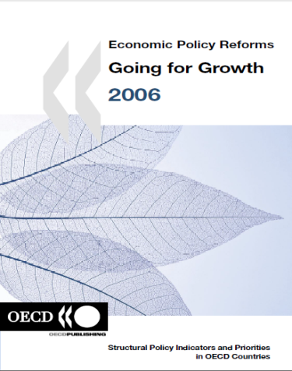
Long standing OECD work on measuring progress “beyond GDP”: from early 2000s…

Slide 5
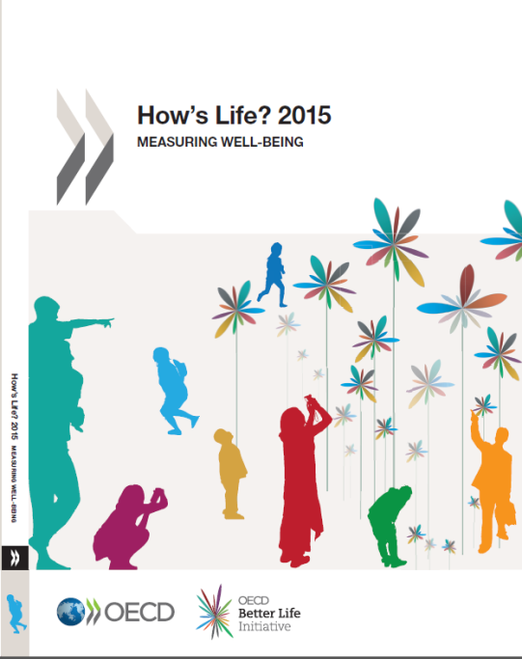
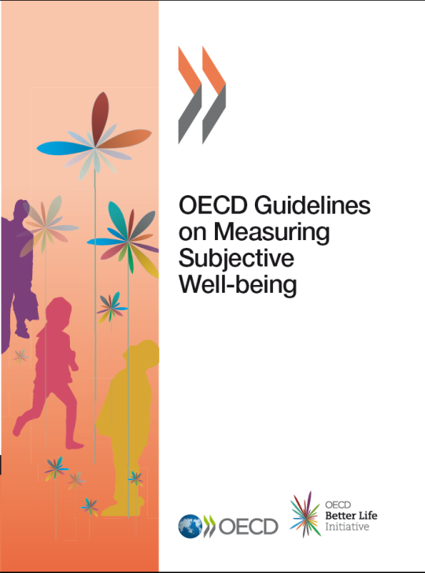
.. to 2015
5th OECD World Forum Guadalajara, 13-15 October 2015
Analysis, monitoring, benchmarking
Statistical agenda: improving metrics
Inputs to policy use (IG project)

Slide 6
Growing international recognition and development of many national initiatives
International recognition:
Stiglitz-Sen-Fitoussi report
EU 2020; Eurostat sponsorship
G20 Leaders statement to “encourage work on measurement methods so as to better take into account the social and environmental dimensions of economic development”
UN Resolution calling for “holistic approach to development” to promote sustainable happiness and well-being
Rio+20 Outcome document and post-2015 agenda to develop Sustainable Development Goals
At national level:
Development of well-being indicators
the United Kingdom, Italy, Germany, Austria, Israel, Mexico
Use well-being indicators in the policy process (some examples)
framework for policy advise by New Zealand and Australia’s Treasuries
accountability tool by Scottish Government
linked to the budget process in Israel and France
In 2011, the OECD launched its Better Life Initiative as part of its new mission to achieve Better Policies for Better Lives
Notes:
6

Slide 7
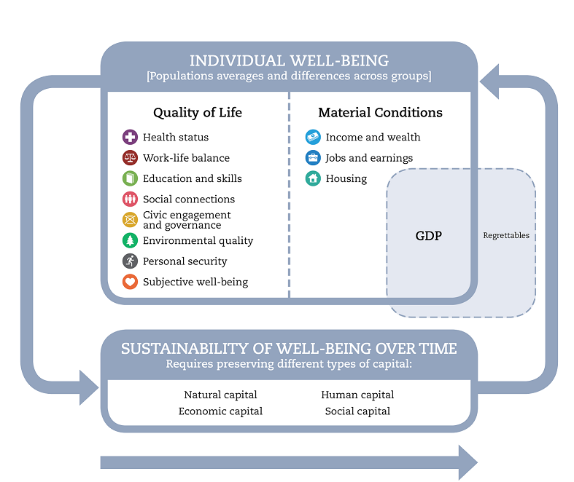
The OECD well-being framework
People rather than economic system or GDP
Outcomes rather than inputs and outputs
Both averages and inequalities
Both objective and subjective aspects
Both today and tomorrow (as well as elsewhere)

Slide 8
Populating the framework with indicators ...
Monitoring countries’ performance across 11 dimensions through dashboard of OECD Indicators:
25 headline indicators, around two per dimension
About 30 secondary indicators to complement the analysis on specific topics
Selection process involving OECD Committee on Statistics and Statistical Policy
Covering OECD and key partner countries

Slide 9
… selected though well-defined criteria
Relevance
face valid (does it match what you want to capture? )
clear interpretation (is ‘more’ better?)
policy relevant (can it be changed?)
Data considerations
official or established sources (non-official place-holders)
comparable/standardized definitions
maximum country-coverage
recurrent data collection
can be disaggregated by population groups

Slide 10
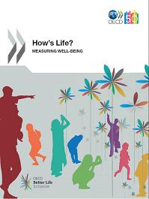
Wide (and growing) range of applications
In-depth statistical reports: How’s Life? 2011; 2013; 2015
Communicating with citizens and the media: Your Better Life Index website www.oecdbetterlifeindex.org
Building well-being measures into OECD country reviews: Economic Surveys, Multidimensional Country Reviews
Projects to adapt the framework for new uses: well-being for development, How’s Life in Your Region?
Notes:
10

Slide 11
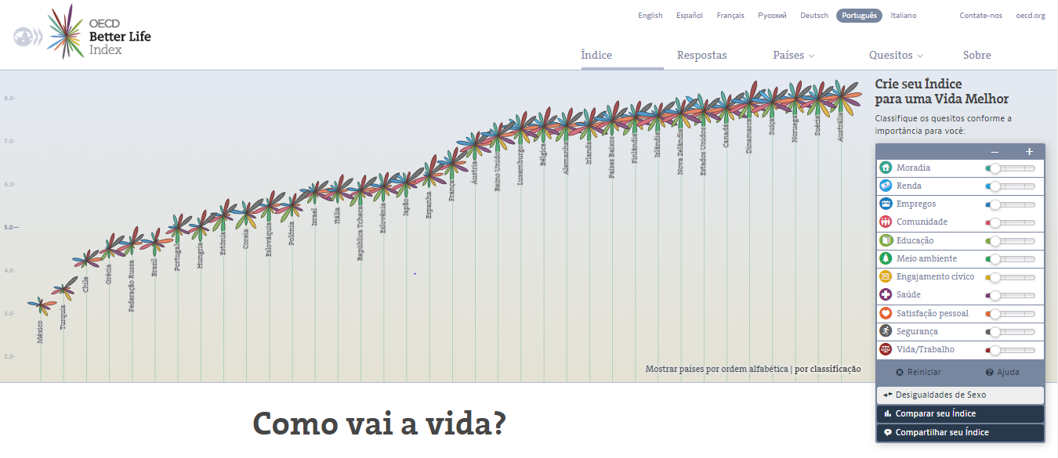
Engaging citizens: online interactive tool Your Better Life Index
Notes:
Innovative: allow users to create their own composite index >assign a weight to each of the 11 dimensions of the OECD well-being framework
Interactive web application designed to involve people in the discussion on well-being and to learn what matters the most to them (communication tool)
Users can see how countries’ average (and by gender) achievements compare based on one’s own personal priorities in life, compare their choices with peers and share their index with other people in their network and with the OECD

Slide 12
How’s Life in Latin America ? Initiative
launched in the framework of the 5th OECD World Forum on Statistics, Knowledge and Policy: Transforming Policy, Changing Lives
jointly led by the Development Centre and the Statistics Directorate of the OECD
relevance of well-being and the need of measuring well-being and progress “beyond GDP” for countries at all levels of development
7 countries have signed on to the Initiative: Bolivia, Chile, Colombia, Costa Rica, Dominican Republic, Mexico and Peru
applying an adapted framework to systematically measure multi-dimensional well-being and benchmarking its progress over time, reflecting their own specific contexts and realities
list of well-being indicators to be included in the 2017 edition of the Latin American Economic Outlook (LEO) (November 2016)

Slide 13
II. What does the evidence show for Brazil?

Slide 14
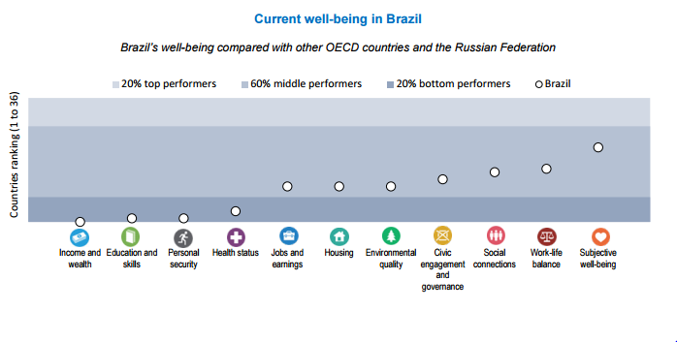
How is Brazil doing? A bird-eye’s view
From BLI country page (June 2015)

Slide 15
What matters the most to people in Brazil?
Source: OECD Better Life Index

Slide 16
III. Policy uses of well-being indicators

Slide 17
The role of Key National Indicators
“whole of government” vision
Key national indicators
“cascading”
(i.e. tools put in place by centres of government to assure the vision translates with actions of individual agencies)
Notes:
This session is about KNI, but if you allow me I would like to take a step back from indicators as such, to better understand their role.
When the vision is narrow, and does not talk to the various government agencies, the cascading will not happen.

Slide 18
The value-added of the policy integrated framework for well-being
Notes:
It helps performing 3 tasks that are central in policy-making

Slide 19
1. Alignement
Across government agencies
Across the policy process
Transcend the silo-approach, setting a multidimensional policy objective function (explicitly modelling relationships outcomes-policy drivers)
The development of an explicit outcome framework ->
generates interactions between government agencies
finally ensures a basic level of consistency across the whole government
> Coordination and Consistency

Slide 20
2. Analysis
Strategic level (def. priorities)
Technical level (costs-benefits analysis)
Information within the OECD well-being framework:
Assessment of well-being performance (cross-comparative, over time, across subgroups of the population)
Study of people’s preferences
Understanding the levers of action for policy
Sound understanding of mechanisms and pathways that generates the outcome s of interest (“production functions”, the interconnections, role of policies and non-policy drivers...)

Slide 21
3. Accountability
For results at all levels is fundamental to efficient and effective governance
Ultimate rationale for
Evaluation of policy interventions ex-post
Input into strategic priority setting

Slide 22
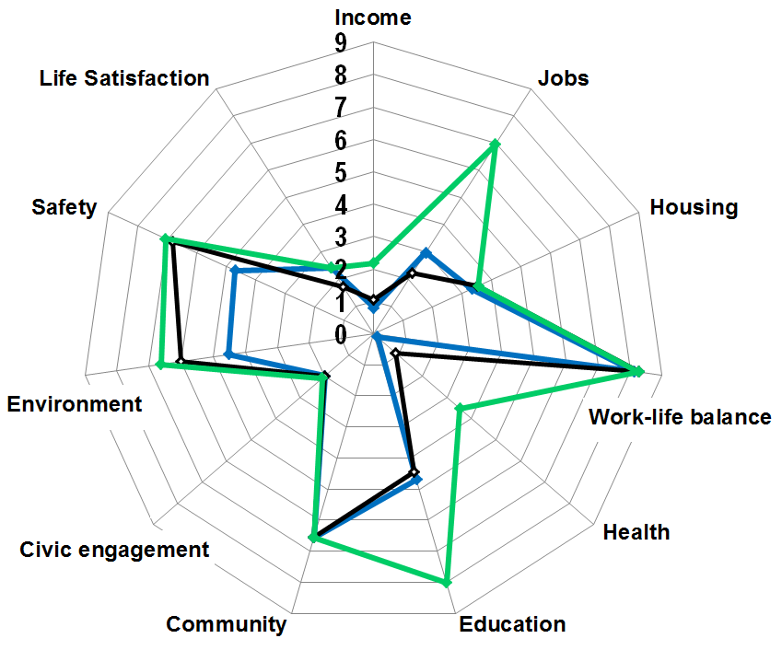
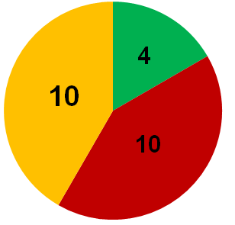
Estimation of the BLI on Russian policy targets
Actual value of BLI in 2011
Indicators computed on the base of policy targets values
Indicators explicitly used as policy targets
Estimation of BLI value
Indicators of OECD Better Life Index
 | 2008 | 2011 | 2018
Average assessment | 3,66 | 3,96 | 5,20
Assessments balance | 0,70 | 0,78 | 0,88
Indicators with values unchanged since 2011
Actual value of BLI in 2008
Estimated policy target for 2018
Source: Anton Kosyanenko, Accounts Chamber of the Russian Federation

Slide 23
Thank you!

