Slide 1
Building a long-term view in government and society: Suggestions from Behavioral Science
Robert Levine
California State University, Fresno
Int’l Seminar on Governance and Development: Good Practices and the role of External Control
Tribunal de Contas da União/OECD
November 4, 2015

Slide 2
1. Time and Brazil
Study 1: Punctuality and Manhã
Notes:
Esperar; to hope, to wait, to expect
Never put off till tomorrow that which you can do today. --Benjamin Franklin
Never do today what you can put off till tomorrow. --Aaron Burr
Never put off until tomorrow what you can do the day after tomorrow. --Mark Twain

Slide 3
Clock Time vs. Event Time

Slide 4
Study 2: The Pace of Life in 31 Countries

Slide 5
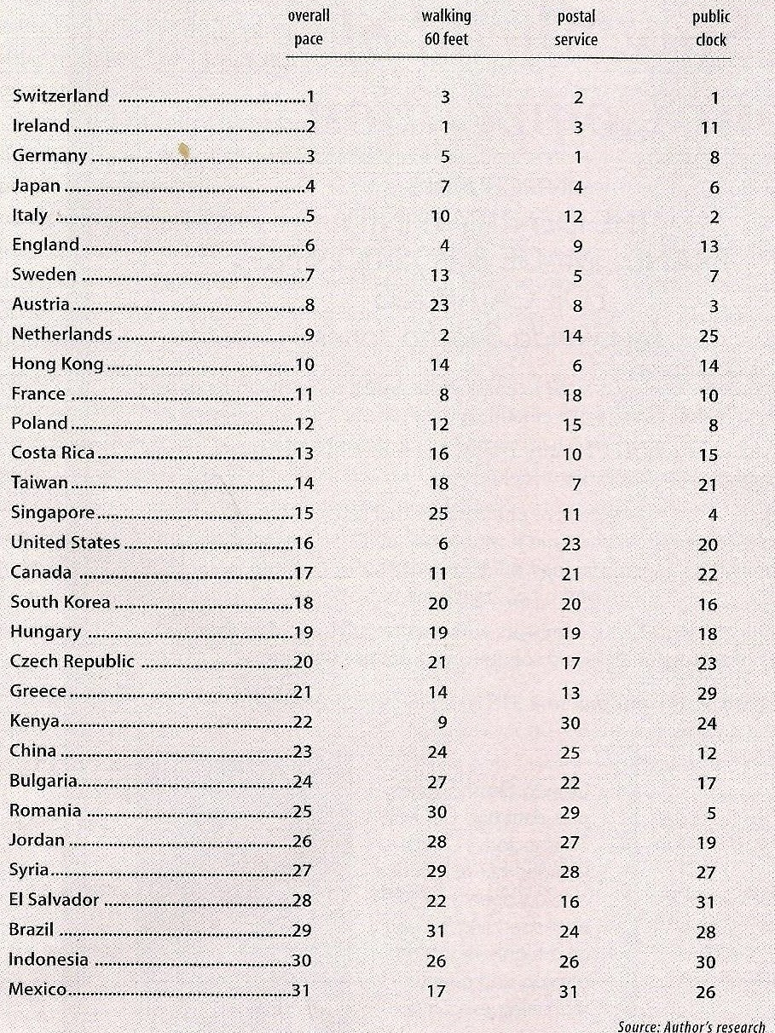
Source: Levine, A Geography of Time

Slide 6
Consequences of a fast pace of life
Economic well being
Less poverty
More work stress
Less attention to people in the here and now
Notes:
i. 1. Spontaneous and people oriented
2. But, present-oriented, not amenable to long-term planning

Slide 7
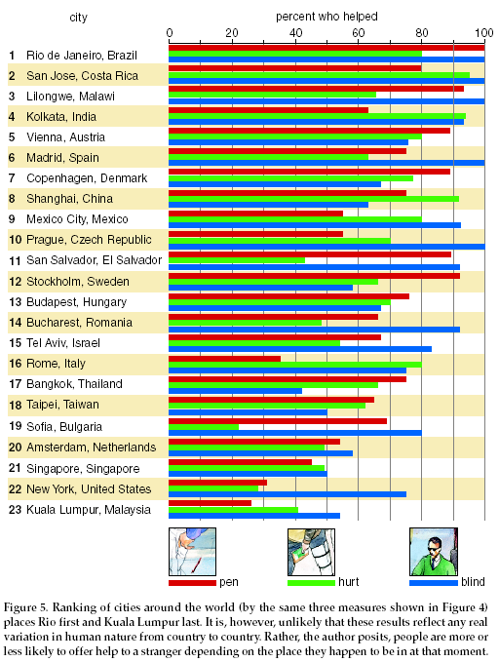
Source: Levine, R. The Kindness of Strangers, American Scientist, 2003

Slide 8
Consequences of the Pace of Life
In sum, a double edged sword
Notes:
i.

Slide 9
2. The value of long-term planning: Achievement and Delay of Gratification
Mischel’s marshmallow study
The dilemma: Impulsive vs. Reflective Action; Present vs. Future -Oriented Decision
Sixteen years after the original experiment, those (now teenagers) who’d been able to wait out the full 15 minutes:
Had higher grades in high school,
better SAT scores and were more emotionally and social competent on a variety of measures.
And, 40 years later
more likely to graduate college,
earned higher incomes,
got into less trouble and had more productive lives in many other ways.

Slide 10
Long-Term Planning Attributes favored by high-level future orientation organizations
Besides achievement and delay of gratification . . . .
Communication
Compassion/caring for others
Delegation
Honesty
Other-oriented:
Developing others
Helping subordinates grow and succeed
Putting subordinates first
Team building
From: Global Leadership & Organizational Behavioral Effectiveness (GLOBE) Project (2011)

Slide 11
4. A few suggestions
Be sensitive to automatic reactions
The silent language of culture
Hyperbolic (future) discounting
Sunken costs
Overcoming loss aversion
Commitment and consistency
A call for behavioral science
Thinking like a psychologist

Slide 12
The Past, Present and Future
“The distinction between the past, present and future is only a stubbornly persistent illusion.” (Albert Einstein

Slide 13
The Persistent Illusion
Chris Mihm: What is an issue going to do us in the future and how is it already looking today?
Janos Bertok: The future started in the past.
The future is simply many presents.
How we planned our future in the past determines the quality of our present.
Matching the strategy to the task
Using event time thinking to plan the long term future

Slide 14
Time perspective and financial health
People who are excessively present oriented (either indulge hedonistically or feel stuck in the present) are most likely to be financially unhealthy.
People who are future oriented are slightly more likely to be financially healthy. They have high self-perceptions of financial literacy but not necessarily a higher degree of financial health.
People who are past oriented are most likely to be financially healthy.
Source: Zimbardo, Philip & Magnify Money, “Time perspective and financial literacy” (unpublished data set)

Slide 15
The importance of maintaining systematic national indicators of progress and changing needs

Slide 16
Source: Diener, Ed., Oishi, S., Lucas, R. E. (2015). National accounts of subjective well-being. The American psychologist, 70(3), 234-242.

Slide 17
What matters most to people around the world? OECD Better Life Index (http://www.oecdbetterlifeindex.org/responses/ (note--need to hover mouse on data points).

Slide 19
The Illusion of Personal Invulnerability
“The tendency for an event to occur varies inversely with one’s preparation for it.” --David Searls

