Slide 1
Governing Complex Education Systems
Florian Köster
4 November 2015
Brasilia

Slide 2
Governing Complex Education Systems
What can central governments still do in highly decentralised systems?
Do local governments have the capacity to govern, and are they held accountable by stakeholders?
What issues arise from multilevel governance where power is spread over different levels, e.g. co‑ordination, conflict, trust?
Notes:
Multilevel system as Brazil is one
TRANSITION
Complexity theory is one of the frameworks we use
This is true for education as much as for other policy areas

Slide 3
Simple, complicated and complex problems
Following a recipe
Recipes are essential
Recipes are easily replicated
Expertise is helpful but not required
Produces a standardised product
Best recipes give good results every time
Simple | Complicated | Complex
Sending a rocket to the moon
Formulae are critical
Sending one rocket increases assurance that the next will be ok
High levels of expertise in multiple fields needed
Rockets are similar in critical ways
High degree of certainty in the outcome once the original issues are solved
Complex Raising a child
Formulae with limited application
Raising one child gives experience, but no assurance of success with another
Expertise can contribute but not sufficient for success
Each child is unique and must be approached individually
Uncertainty of outcome remains
Source: adapted from Snyder (2013); based on Glouberman, S., & Zimmerman, B. (2002)
Notes:
Some problems are simple - what all countries struggle with are the complex problems.
In the realm of complex problems the traditional policy cycle does not capture the realities of public policy
How are complex problems unique?
Governance often follows a complicated approach for complex problems

Slide 4
GCES Core Themes
Accountability
Capacity building
Strategic thinking
Notes:
Through our work with countries, three main themes emerged: …
I will go over each in turn

Slide 5
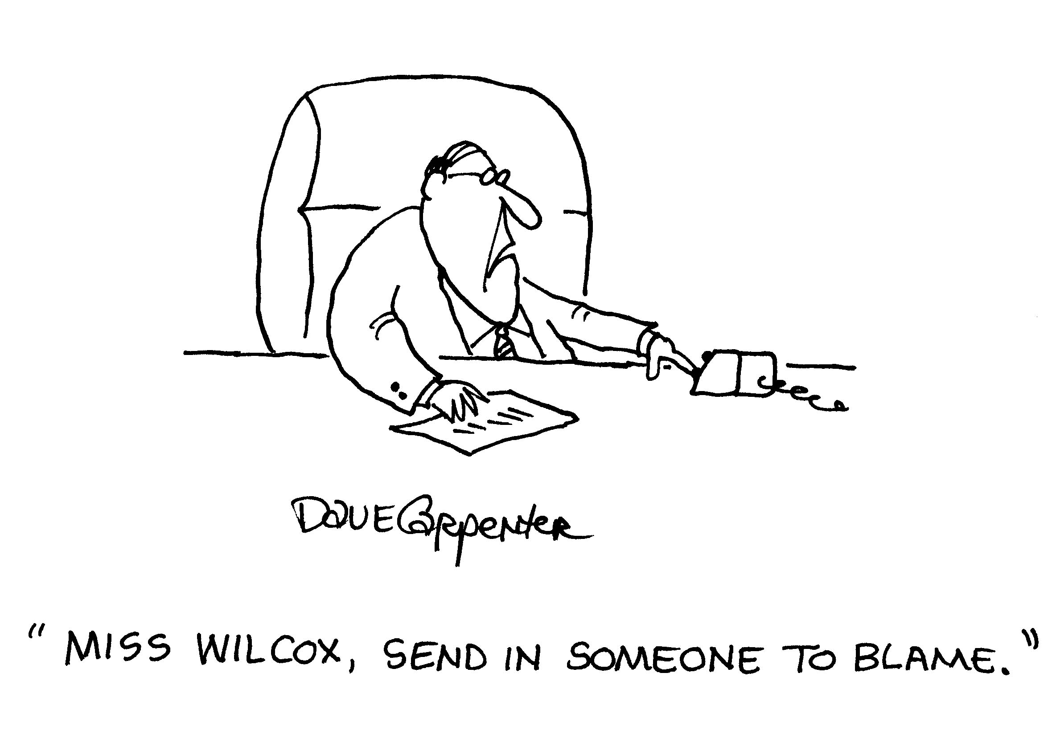
Accountability
In decentralized systems, other forms of accountability take a greater role
Cartoon by Dave Carpenter
Notes:
In decentralized systems, other forms of accountability take a greater role, as traditional hierarchical control is ineffective
Challenges
Who is being held accountable and what for?
Is it used to punish, or to improve? Who should be involved?
Legitimacy: with more dynamic relationships and outside hierarchical control, accountability has greater need for legitimacy

Slide 6
Accountability
Potential trade-offs
Trust
Innovation
Complementing hierarchical accountability with stakeholder accountability
Notes:
Moving beyond control as accountability: trust
Trust as a basis for legitimate governance structures
Trust: more control, less trust – less trust shuts the door on more dynamic forms of accountability
Innovation and risk management
What is the right system of accountability?
Perspective: “Only a strong vertical accountability system can serve the purpose of accountability (i.e., the efficient use of state resources to deliver education services).”
In complex systems with diversified structures and new stakeholders, it could be beneficial to complement hierarchical accountability structures by stakeholder accountability “telling the story behind the numbers”
Example education: comprehensive perspective on the system and school performance, linking education with wider policy goals like social inclusion
------------------------------------
Education example
In Israel schools had serious issues with parents picking up their children late
Schools started to fine parents if they were late
This led to the contrary effect that parents came even later
“Hey I’m paying for this so I’ll be as late as I want”
To effectively involve stakeholders in the accountability system, they need to feel responsible for the outcome of the system
Be careful with the commodification of stakeholder relations
------------------------------------
TRANSITION
Our second theme is capacity building

Slide 7
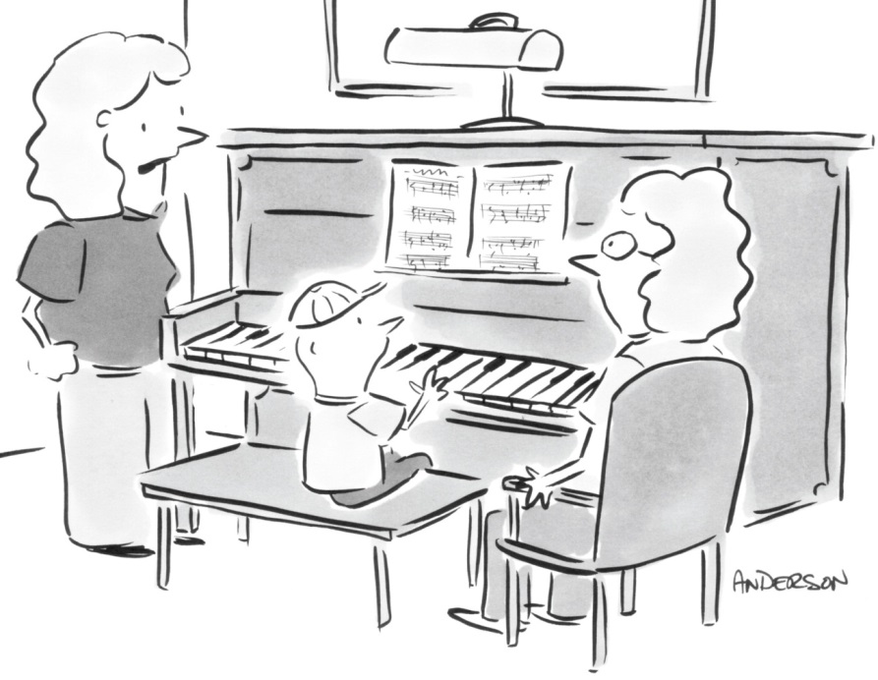
Capacity Building
With greater autonomy, the local level needs the capacity to adapt policies to their local context
Change management
“How expensive would it be to skip practice and get right to perfect?”
Notes:
A key element of successful policy reform is ensuring that local stakeholders have sufficient capacity to fulfill new roles.
adequate knowledge of policy goals and consequences,
As well as tools to implement policies as planned.
Without these, the best policy reform risks being derailed at the local level.
Change management
Capacity building not a deficit model
actors need to be incorporated in the process
Different needs among stakeholders
Defining roles what is expected of whom, ownership
TRANSITION
Knowledge production
Tyranny of common sense

Slide 8
Capacity Building
Towards public policy based on evidence and indicators
Knowledge production/use
“Tyranny of common sense”
Notes:
Capacity building particularly on the local level
Knowledge
In decentralised systems, both where knowledge is produced and where it is used is scattered across levels. This requires knowledge sharing and cooperation.
Knowledge sharing in itself can build capacity and increase trust among stakeholders
In education sometimes a tyranny of common sense is observed
Tyranny of common sense: no access to information, no capacities of using the provided information, teachers working on beliefs and myths, policy implementations based on beliefs and myths (no evidence-based background, because no access to information and no capacities to use it even if access). Ties closely to accountability and a culture of assessment. → Swedish case study
TRANSITION
Our third and last theme is Strategic Thinking

Slide 9
Strategic Thinking
Increased need for strategic thinking on all levels
However, capacity an issue
Strategy as practice, acknowledging complexity
Notes:
Strategic thinking is needed to know where to go and how to get there while continually adapting to changing context
Decentralization and increasing autonomy increase the need for strategic thinking at the local level
At the same time there are serious problems with the capacity for such strategic thinking especially outside larger cities.
The central level has an important role to play in supporting strategic thinking at the local level: capacity building, providing information and offering frameworks.
Strategic thinking needs to be a practice – continually anticipating and adapting to changes while keeping goals in mind and how to get there. This includes futures thinking but is distinctively different from long-term planning which attempts to anticipate future developments in full.
TRANSITION
I will give an example that touches on all three of these themes: Decentralization of Education to the municipal level in Sweden

Slide 10
GCES Case Study: Sweden
Decentralisation reforms in Sweden since the 1990s
Shifted virtually all responsibilities to municipalities
Notes:
From a formerly highly centralized system, responsibilities for education were shifted quickly to the municipal level
The municipalities received block grants, in no way earmarked for education
A system of assessment was introduced to inform municipalities of education performance
while sanctions were kept at a minimum

Slide 11
GCES Case Study: Sweden
Three main findings:
Lack of a strategic vision
Capacity challenges for governance
Mismatch between powers and responsibilities
Notes:
Lack of systematic vision:
The quick shift in responsibilities meant that municipalities were unclear of what they were expected to do
Capacity challenges for governance:
The central level didn't want to interfere with municipal autonomy and abstained form providing frameworks
Particularly small municipalities lacked sufficient capacity internally to accommodate the new responsibilities
Mismatch between powers and responsibilities:
Devolution means few tools for central authorities to incentivise compliance with national goals. (Cf. especially the use of block grants rather than target funds.)
At local level, funds are often attributed on the basis of tradition, rather than on a clear understanding of actual needs - Despite the availability of data
TRANSITION
In terms of recommendations

Slide 12
GCES Case Study: Sweden
Three main recommendations:
Increase local accountability
Build local capacity
Strengthen systemic strategic vision
Notes:
Increase local accountability:
Decision-making must take account of research, data, and expert guidance.
There is a need for more involvement of parents, as well as the community and citizen more broadly, to push education as a main issue.
Build local capacity
Central authorities can provide more guidance on priority setting, and provide extra help to smaller municipalities.
They can also facilitate inter-municipal collaboration, exchange of best-practice, and assistance to pool both skills and costs.
Strengthen systemic strategic vision:
Central authorities can encourage municipalities to develop long-term thinking through workshop and discussions
They can also use ear-marked funds to protect education, keeping the output-focus of the grant
TRANSITION
This is just one example – all of our case studies and working papers that discuss these topics can be found on our website
I’ll finish with our main findings that emerged from all of our work

Slide 13
GCES Main Findings
There is no one right system of governance Rather than focusing on structures it is more fruitful to focus on processes
Effective governance works through building capacity, open dialogue, and stakeholder involvement
Governance is a balancing act between accountability and trust, innovation and risk-avoidance, consensus-building and making difficult choices
Notes:
Federal or unitary, centralized or decentralised

Slide 14
GCES Main Findings
The central level remains very important in triggering and steering reform through strategic vision, clear guidelines and feedback
There are systemic weaknesses in capacity which contribute to today’s governance challenges
Importance of key principles for system governance where to go and how to get there
Notes:
The central level remains very important (even in decentralised systems) in triggering and steering education reform through strategic vision, clear guidelines and feedback.
There are systemic weaknesses in capacity throughout most educational systems which contribute to today’s governance challenges.
Importance of key principles for system governance (not just agreement on where to go, but how to get there).

Slide 15
www.oecd.org/edu/ceri/gces florian.koester@oecd.org

