Slide 1
Assessing long-term strategic documents with the EU perspective 2014-2020
Supreme Audit Office
Poland
Slawomir Grzelak
Director,
Department of Economy, State Treasury and Privatization
Brasilia, 4 November 2015

Slide 2
The reform of strategic planning
the Development Strategy Rearrangement Plan (the Council of Ministries, November 2009):
from the narrow, sectoral approach – to public policy integration and enhancement
the replacement of over 400 sector strategies to strategic framework (long- and medium-term strategies, 9 cross-sectoral strategies)
preparatory stage - 2010-2012
the system of strategic documents was adopted by the CM at the turn of the 2012-2013
multiannual budgetary planning perspective
Notes:
Pioneer endeavour in Polish realities
The governemenent underook significant efforts to strengthen its capacity to set strategy unified framework. It was conceived the single, long-term vision for development of the country in the year 2030 perspective.
Taking about this strategical framework we have to be aware that long term planning in context of current economy and financial situation within the EU can not be precisely, to put it midly.

Slide 3
National Development Management System
coherent hierarchy of objectives and directions for public funds intervention
key regional development challenges and objectives in various areas
assumptions regarding implementation instruments, monitoring and reporting
evaluation and risk analysis
action plans – linkage between strategic and operational planning
financial forecast
Notes:
The main strategic documents of the new system, on the basis of which the development policy
is implemented, include: Long-Term National Development Strategy - LTNDS (Poland 2030 - Third
Wave of Modernity) which defines major trends and challenges as well as the concept of
development of the country in the long-term, Medium-Term National Development Strategy -
MTNDS (National Development Strategy 2020) which is the most important document in the
medium term, setting out strategic objectives for the development of the country until 2020, and
key in determining the development activities, including those that can potentially be funded
under the UE financial perspective 2014-2020 and under 9 Integrated Strategies whose aim is to
assist in achieving the development objectives: Strategy for Innovation and Efficiency of the
Economy, Human Capital Development Strategy, Transport Development Strategy, Energy
Security and the Environment, Efficient State, Social Capital Development Strategy, National
Strategy of Regional Development 2010-2020. Regions, cities, rural areas , Strategy for
Development of the National Security System, Strategy for Sustainable Development of Rural
Areas, Agriculture and Fisheries. LTNDS, MTNDS and the 9 Integrated Strategies are joined by a
coherent hierarchy of objectives and directions for intervention. The Integrated Strategies depart
from a narrow sectoral approach, instead they focus on the integration of areas and on the
permeability of various phenomena and processes. The National Strategy of Regional
Development, which indicates the extent of the territorial impact of interventions implemented
under various public policies, and therefore also under the remaining Integrated Strategies, has a
particular role in the entire system. It sets out the key regional development challenges and
outlines the development objectives in various areas, taking into account the functions such
objectives perform as well as the existing potentials and barriers.
The concept of spatial development of the country (National Spatial Development Concept
2030)1 represents the spatial framework for the development policy in Poland, including the
implementation of various development strategies. It is the main strategic document for the
creation of spatial order in Poland, which also addresses the issues related to the development,
where the space is treated as a plane of reference for development activities.
1

Slide 4
The strategic documents system
Notes:
Due to the adopted procedure and the
schedule of work on these documents, they are closely correlated and mutually determine each
Other.

Slide 5
The strategic documents system
Notes:
MTNDS determines the key indicators reflecting the progress towards the objectives set in the
selected strategic areas, and it indicates the paths leading to the levels designated, which are the
guidelines for the directions of interventions, activities and indicators detailed in nine Integrated
Strategies.
The concentration of public funds on the implementation of a limited number of priorities, essential
for ensuring economic growth and competitiveness of the economy, will prevent them from
spreading, and thus being used ineffectively.

Slide 6
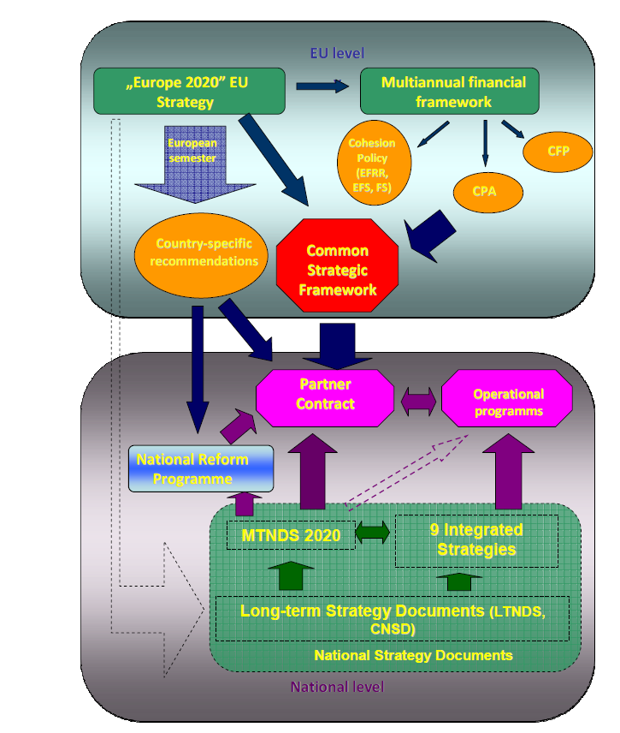
The relationships between the national and EU documents

Slide 7
The audit of long-term strategic documents preparation
Main audit goal – assessment of the strategic planning system creation process
Detailed audit objectives were formulated in reference to key actors:
The Prime Minister Chancellory (supervision, production of LNDS)
The Ministry of Regional Development (coordination, production of NDS
Ministries responsinble for integrated strategies
Notes:
This allowed us to become a partner for the government in discussions on strategic planning

Slide 8
The audit of long-term strategic documents preparation
Audit axes
Compliance – whether ministries followed terms and conditions at the preparatory stage
Coherency of strategies, their assumptions, indicators, logic schemes

Slide 9
The audit of long-term strategic documents preparation - methodology
Analysis of minutes confirming works of the Coordination Committee
Analysis of drafts, experts opinions, consultants reports, benchmarks, indicator sets
Analysis of decisions made by ministries in charge
The audit program – as a framework, agile approach
Notes:
We had to dig through piles of documents

Slide 10
Audit results
General opinion – positive, despite identified irregularities (medium)
Identified systemic problems:
The only one scenario of social and economy development of the country (LNDS)
The sequence of strategies preparation and adoption was disturbed (rather accidential)
The lack of LNDS during most of the preparatory period (lack of proper benchmarks)
Unnecessarily delays in drafting, consultations and arrangements (low efficiency and cooperation)
Incompliances with provisions included in legal acts
Framework timetable has not been met
Notes:
Executive documents should be adjusted to the directional document. Part of them had been adopted by the CM before LNDS came into force. Works devoted to preparation of some executive strategies were prevented and suspended due to absence of the LNDS.

Slide 11
Audit results
Positive aspects
The system works and constitutes a base for several development activities
Executive strategies are provided with measurers and indicators – monitoring
Suitable methodology, enabling preparatory stage
Efforts related to capacity building of the administration in development policies
Sufficient quality of executive documents

Slide 12
Audit conclusions
To the Government
Establish a central entity responsible for country development policies coordination and implementation
External and internal surrondings analysis
Strategies modifications and updating
Conducting researches
Ensure proper linkage between long term planning system and multiannual budgetary perspectives
Notes:
it should be noted that this was in a sense an episodic project, hence it was not easy for us to draw conclusions about a system which would be relevant timeless.

Slide 13
Thank you for your attention
Obrigado

